Slide 1
Chapter 10 Search Trees

Slide 2
Binary SearchTrees

Slide 3
Binary Tree
Hierarchical structure of linked nodes—parents and children.
Binary tree: two children at most.
Multiple levels: grandchildren, grandparents, descendants, ancestors.
Top node is called the root.

Slide 4
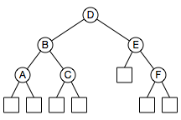
Example Search Tree
Trees are made up of smaller trees— subtrees. Node B is the root of a subtree; so is A.
Internal nodes (circles) contain keys and values; keys are identifiers that are searched for.
External nodes mark the bottom of the tree; they have no children and no content.
Left subtree’s keys are less than the root’s key, right subtree’s keys are greater.

Slide 5
Operations
Insert: add a node
Find: locate a node with a specific key
Erase: remove a node
Find is used by:
Insert, to determine the position of the new node
Erase, to determine the position of the node to remove

Slide 6
Find
Navigate left and right down the tree
At each node, compare node key to search key
If they match, search terminates successfully
If search key is less, go down to left subtree
If search key is greater, go down to right subtree
If no match has been found when bottom of tree is reached (no left or right subtree to descend to), search terminates unsuccessfully.

Slide 7
Insertion
Two possibilities:
Node with key already exists in tree
No node with key exists in tree
A Find for a key that doesn’t exist terminates at the external node at the position where the internal node would have been, and where the new node should be.
A Find for a key that already exists causes links to be followed down to the right until an external node is reached—the end of the chain of duplicate keys.

Slide 8
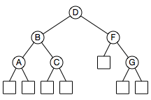
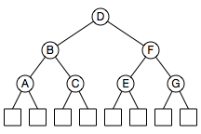
Insert: key not already in tree
Before node E is inserted
After node E is inserted

Slide 9
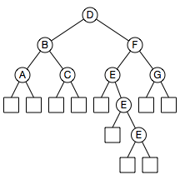
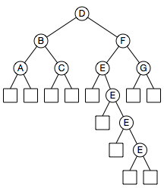
Insert: duplicate keys already in tree
Before another node E is inserted
After one more node E is inserted

Slide 10
Erasure
The most complicated operation.
Removing a node leaves a hole that must be filled.
Filling the hole involves promoting another node, internal or external.
Three different situations, depending on number of node’s external children: two, one, or none.

Slide 11
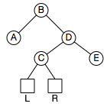
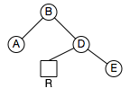
Two External Children
Erase node C
Promote node C’s right child into node C’s position
Delete node C and its left child, resulting in:

Slide 12
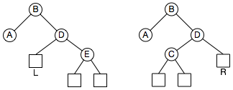
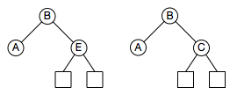
One External Child
Two complementary variations
Erase node D by promoting its internal child

Slide 13
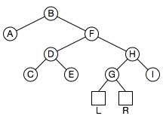
No External Children
Most complicated case; node F has two internal children.
There’s no external child, no single internal child.
It should be replaced by its logical successor, node G.
Find F’s successor by going right, then left, left,…

Slide 14
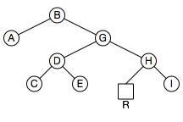
Node G won’t be linked into node F’s position; its key and value will be copied.
Old node G’s right child will be promoted to fill G’s position.
Old node G and its left child will be deleted.

Slide 15
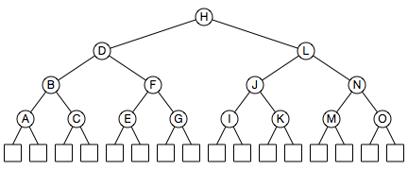
Iterator
Performs inorder traversal, visits nodes in key order.
Navigates down, left, right, up, down again

Slide 16
Finding a Node’s Successor
If there is a right subtree, it’s at the lower left corner.
If there is no right subtree, it’s at an ancestor—the ancestor of the left subtree that the node is in.
Node B’s successor is node C; node C’s successor is node D.

Slide 17
Related Functions
Begin(). Returns an iterator to the first node.
End(). Returns an iterator to the end of the tree, which is actually one beyond the last node.
“Half-open Range” viewpoint—reaching the end of the range means advancing beyond the last element.
Loop: for(i = tree.Begin(); i != tree.End(); ++i)
The typical array loop—for (i = 0; i < size; ++i)—uses the same viewpoint:
If size is 10, i goes from 0 to 9; loop stops when i is 10, one position beyond the end of the array.

Slide 18
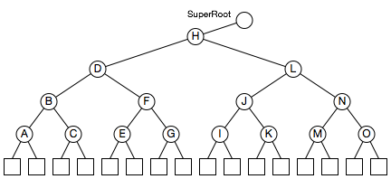
Root and SuperRoot
The tree needs a node that’s logically beyond its last node.
The root will get a parent—a SuperRoot.

Slide 19
Reaching the End of the Tree
Node O’s successor is the ancestor of the left subtree that node O is in.
That ancestor is the SuperRoot.

Slide 20
C++ Implementation of a Binary Search Tree (Section 10.1.3 Simplified)

Slide 21
template<typename K, typename V>
struct Node
{
Node() : parent_(NULL), left_(NULL), right_(NULL) { }
V operator*()
{ return(value_); }
bool IsRoot() const
{ return(parent_ == NULL); }
bool IsExternal() const
{ return((left_ == NULL) && (right_ == NULL)); }
K key_;
Node* left_;
Node* parent_;
Node* right_;
V value_;
};

Slide 22
template<typename K, typename V>
class BinarySearchTree
{
public:
class Iterator
{
public:
Iterator() { }
Iterator(Node<K, V>* node) : node_(node) { }
const Node<K, V>& operator*() const { return(*node_); };
Node<K, V>& operator*() { return(*node_); };
bool operator==(const Iterator& p) const
{ return(node_ == p.node_); }
bool operator!=(const Iterator& p) const
{ return(node_ != p.node_); }
Iterator& operator++();
private:
Node<K, V>* node_;
friend class BinarySearchTree;
};

Slide 23
BinarySearchTree();
Iterator Begin();
bool Empty() const;
Iterator End();
bool Erase(const K& key);
void Erase(const Iterator& i);
Iterator Find(const K& key);
Iterator Insert(const K& key, const V& value);
void Show(ostream& stream);
int Size() const;

Slide 24
private:
Node<K, V>* Eraser(Node<K, V>* node);
void ExpandExternal(Node<K, V>* node);
Node<K, V>* RemoveAboveExternal(Node<K, V>* node);
Node<K, V>* Finder(const K& key, Node<K, V>* node);
Node<K, V>* Inserter(const K& key, const V& value);
Node<K, V>* root_;
int size_;
Node<K, V>* superRoot_;
};

Slide 25
template<typename K, typename V>
BinarySearchTree<K, V>::BinarySearchTree()
{
size_ = 0;
// Create the super root and make its left child the logical root of the tree.
superRoot_ = new Node<K, V>;
ExpandExternal(superRoot_);
root_ = superRoot_->left_;
}

Slide 26
template<typename K, typename V>
typename BinarySearchTree<K, V>::Iterator BinarySearchTree<K, V>::Find(const K& key)
{
Node<K, V>* node;
node = Finder(key, root_);
if (!node->IsExternal())
{
return(Iterator(node));
}
else
{
return(End());
}
}

Slide 27
template<typename K, typename V>
Node<K, V>* BinarySearchTree<K, V>::Finder(const K& key, Node<K, V>* node)
{
if (node->IsExternal())
{
return(node);
}
if (key < node->key_)
{
return(Finder(key, node->left_));
}
else if (key > node->key_)
{
return(Finder(key, node->right_));
}
else
{
return(node);
}
}

Slide 28
template<typename K, typename V>
typename BinarySearchTree<K, V>::Iterator
BinarySearchTree<K, V>::Insert(const K& key, const V& value)
{
Node<K, V>* node;
node = Inserter(key, value);
return(Iterator(node));
}

Slide 29
template<typename K, typename V>
Node<K, V>* BinarySearchTree<K, V>::Inserter(const K& key, const V& value)
{
Node<K, V>* node;
node = Finder(key,root_);
while (!node->IsExternal())
{
node = Finder(key, node->right_);
}
ExpandExternal(node);
node->key_ = key;
node->value_ = value;
++size_;
return(node);
}

Slide 30
template<typename K, typename V>
bool BinarySearchTree<K, V>::Erase(const K& key)
{
Node<K, V>* node;
node = Finder(key, root_);
if (!node->IsExternal())
{
Eraser(node);
return(true);
}
else
{
return(false);
}
}
template<typename K, typename V>
void BinarySearchTree<K, V>::Erase(const Iterator& i)
{
Eraser(i.node_);
}

Slide 31
template<typename K, typename V>
Node<K, V>* BinarySearchTree<K, V>::Eraser(Node<K, V>* node)
{
Node<K, V>* remove;
Node<K, V>* removeParent;
if (node->left_->IsExternal())
{
remove = node->left_;
}
else if (node->right_->IsExternal())
{
remove = node->right_;
}

Slide 32
else
{
remove = node->right_;
do
{
remove = remove->left_;
} while (!remove->IsExternal());
removeParent = remove->parent_;
node->key_ = removeParent->key_;
node->value_ = removeParent->value_;
}
--size_;
return(RemoveAboveExternal(remove));
}

Slide 33
template<typename K, typename V>
typename BinarySearchTree<K, V>::Iterator& BinarySearchTree<K, V>::Iterator::operator++()
{
Node<K, V>* next;
next = node_->right_;
if (!next->IsExternal())
{
do
{
node_ = next;
next = next->left_;
} while (!next->IsExternal());
}
else
{
while (node_ == next->right_)
{
node_ = next;
next = next->parent_;
}
node_ = next;
}
return(*this);
}

Slide 34
template<typename K, typename V>
typename BinarySearchTree<K, V>::Iterator BinarySearchTree<K, V>::Begin()
{
Node<K, V>* node;
node = root_;
while (!node->IsExternal())
{
node = node->left_;
}
return(Iterator(node->parent_));
}
template<typename K, typename V>
typename BinarySearchTree<K, V>::Iterator BinarySearchTree<K, V>::End()
{
return(Iterator(superRoot_));
}

Slide 35
template<typename K, typename V>
void BinarySearchTree<K, V>::ExpandExternal(Node<K, V>* node)
{
node->left_ = new Node<K, V>;
node->left_->parent_ = node;
node->right_ = new Node<K, V>;
node->right_->parent_ = node;
size_ += 2;
}

Slide 36
template<typename K, typename V>
Node<K, V>* BinarySearchTree<K, V>::RemoveAboveExternal(Node<K, V>* node)
{
Node<K, V>* child;
Node<K, V>* grandParent;
Node<K, V>* parent;
Node<K, V>* sibling;
child = node;
parent = child->parent_;
sibling = (child == parent->left_ ? parent->right_ : parent->left_);
if (parent == root_)
{
root_ = sibling;
sibling->parent_ = NULL;
}

Slide 37
else
{
grandParent = parent->parent_;
if (parent == grandParent->left_)
{
grandParent->left_ = sibling;
}
else
{
grandParent->right_ = sibling;
}
sibling->parent_ = grandParent;
}
delete child;
delete parent;
size_ -= 2;
return(sibling);
}

Slide 38
template<typename K, typename V>
bool BinarySearchTree<K, V>::Empty() const
{
return(size_ == 0);
}
template<typename K, typename V>
int BinarySearchTree<K, V>::Size() const
{
return(size_);
}

